Slide 1




Victoria Mendez
Hannah Miles-Kingrey
Ethan Shipman
Nathaniel Trief
Early Warning System for At-Risk Students:
Leveraging Data to Reduce Drop-Out Rates

Slide 2


Ethan
Project Proposal
Our goal is to create an Early Warning System for At-Risk Students.
The education dataset, collected via school reports and questionnaires, consists of over 600 individual data instances from two Portuguese classes including attributes such as
demographics
grades
social factors
support
We’re hoping to identify problem areas within students’ environments and potentially reduce the total drop-out rate.
Dataset:
Cortez, P. (2008). Student Performance [Dataset]. UCI Machine Learning Repository. https://doi.org/10.24432/C5TG7T.

Slide 3
Ethan
Key Questions: Potential Risk Factors
extra educational support
parent education level
health
social tendencies

Slide 4





Methodology
Ethan
Data Model Implementation
Data Model Optimization
Prediction & Visualization
cleaned two CSVs (math class data, Portuguese class data)
SQLite database creation
feature engineering
multilabel classification
modifying target
experimenting with model type

Slide 5





Data Model Implementation

Slide 6
Implementation Process
Ethan
Minimal cleaning
Feature Engineering
Attendance Engagement (Balances absences with grades)
Sudden Grade Drop (from G1 to G2)
Low Engagement Flag (Flags students whose engagements levels are in the highest quartile)
Model Types
Logistic Regression - Baseline
Decision Tree - Baseline
Predictions

Slide 7
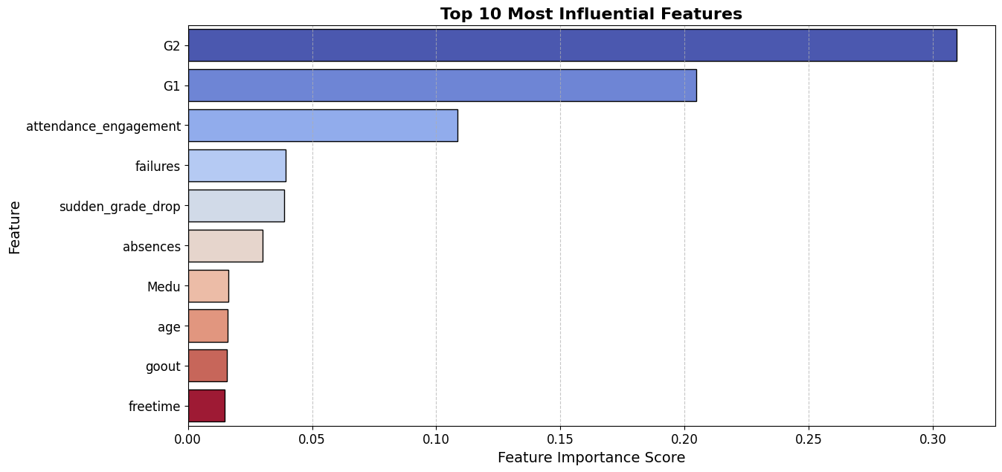

Slide 8
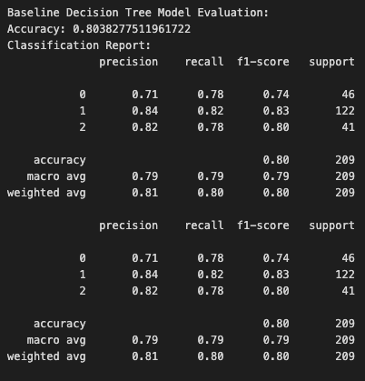
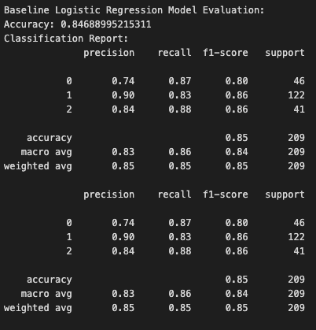
Classification Report for Baseline
Ethan

Slide 9

Hannah
Data Model Optimization

Slide 10
Optimization Process
Hannah
Feature Engineering
Extra Support
Health
Parent Education
Social Tendencies
Experimenting with different targets
G3 (final grade, scale 0-20)
creating a risk category (multiclass labels)
Experimenting with Model Types
Logistic Regression
Highest accuracy (99%)
Decision Tree
Highest accuracy (100%)
Random Forest
Pruned Forest
Highest accuracy (85.65%)

Slide 11

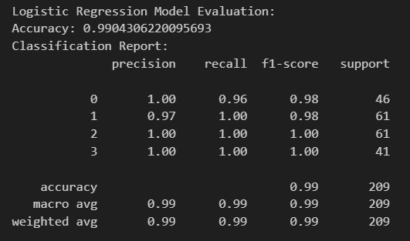

Hannah
Optimizations 1-3 focused on engineering features, yielding 90%+ accuracy.
Optimization 4 focused on modifying the multiclass labels (based on final grades) from three to four risk categories and making this the new target.
0 - ‘at risk’
1 - ‘low risk’
2 - ‘moderate risk’
3 - ‘not at risk’
performs well at classifying ‘moderate risk’ and ‘not at risk’ students
missed some ‘at risk’ students leading to false-positives for ‘low risk’ students.

Slide 12
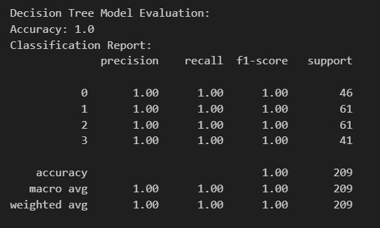
Hannah
The 100% accuracy here may reflect a complex or non-linear dataset.
Extra support features didn’t make a significant difference.

Slide 13


Hannah
Extra Supports

Slide 14
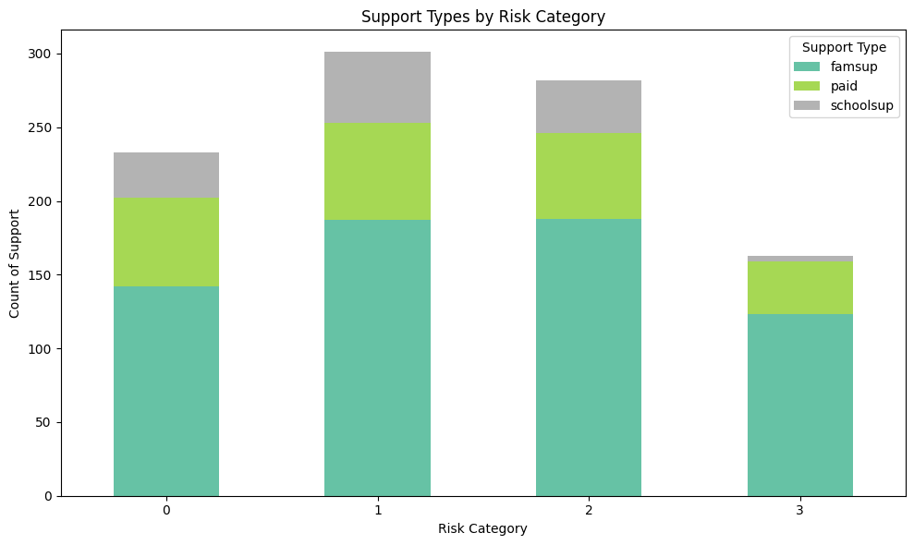

Hannah
Is there a relationship between a student being at-risk and access to extra educational support, family educational support, or extra paid classes within the course subject?
risk category
0 - ‘at risk’
1 - ‘low risk’
2 - ‘moderate risk’
3 - ‘not at risk’
Students identified as being ‘at risk’ receive
more total support than ‘not at risk students’
less than ‘moderate’ and ‘low risk’ students.

Slide 15
Victoria
Influence of Parental Education on Student Performance and Higher Education Interest

Slide 16

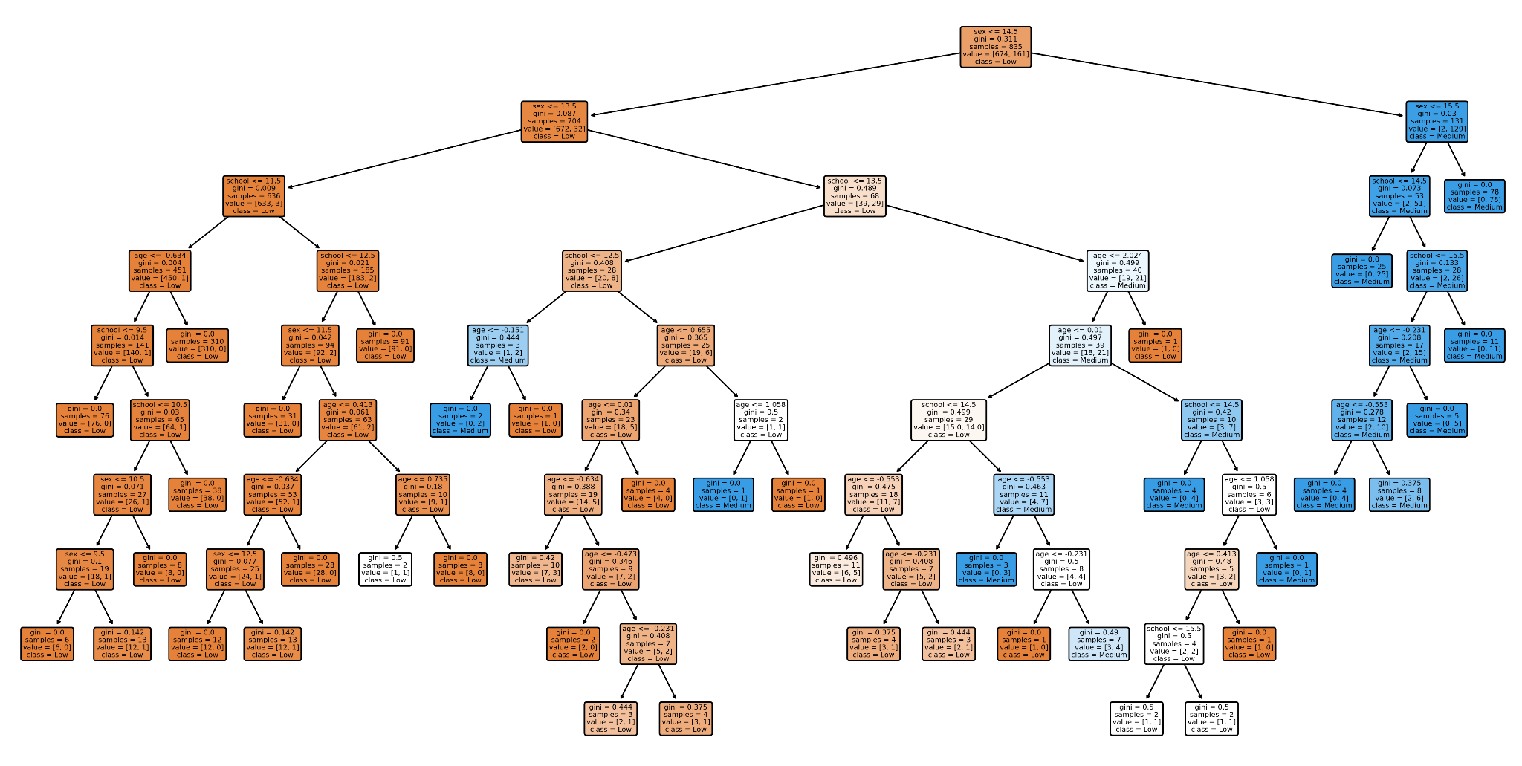
Decision Tree Model for Predicting Student Outcomes
Victoria
Visualization Overview:
The decision tree classifies students into categories (Low, Medium) based on features like school, age, and sex.
Colors:
Orange: Likely "Low"
Blue: Likely "Medium"
White: Mixed classification
Key Observations:
First Split: Based on school, the most significant feature.
Further splits involve age, sex, and school.
Nodes with a Gini index of 0 indicate perfect classification.

Slide 17





Do students with higher-educated parents perform better in final exams (G3)?
Do they show stronger interest in higher education?
Victoria
Key Takeaways:
Class 0 (Not Pursuing Higher Education):
100% precision & recall – no false negatives 🚀
Class 1 (Pursuing Higher Education):
100% precision – all predicted students belong to this class 🎓
86% recall – some students may be missed (false negatives) ⚠️
F1-Score Insights:
High F1-scores for both classes 🔥
Slight preference for precision in predicting higher education students 📊
Higher parental education levels (likely contributing to students' higher academic performance) are strongly associated with students' interest in pursuing higher education.

Slide 18
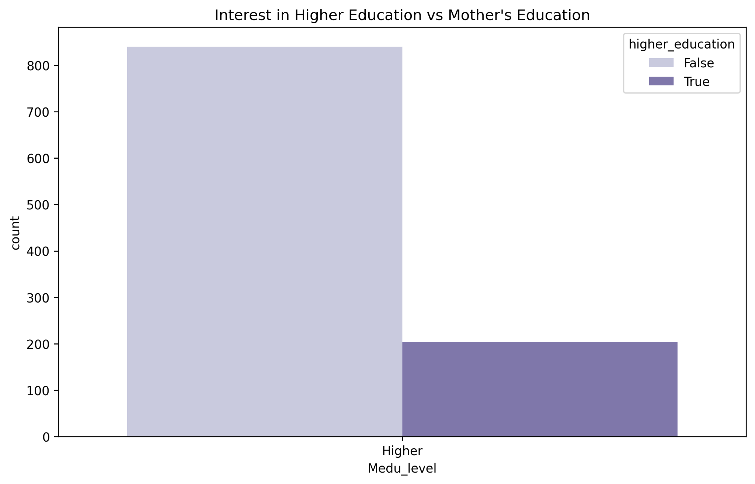


Victoria
A large proportion of students whose parents have lower education levels are not pursuing higher education (lighter bars dominate).
In contrast, students with more highly educated parents show a greater interest in continuing their education (darker bars increase).
This suggests a strong correlation between parental education and a student’s likelihood of seeking higher education.
Notes:
Implications:
Students from higher-educated families may have more academic support and encouragement to pursue higher education.
This highlights potential inequalities—students with less-educated parents might need additional support to increase higher education participation rates.

Slide 19



Ethan
Social Tendencies

Slide 20

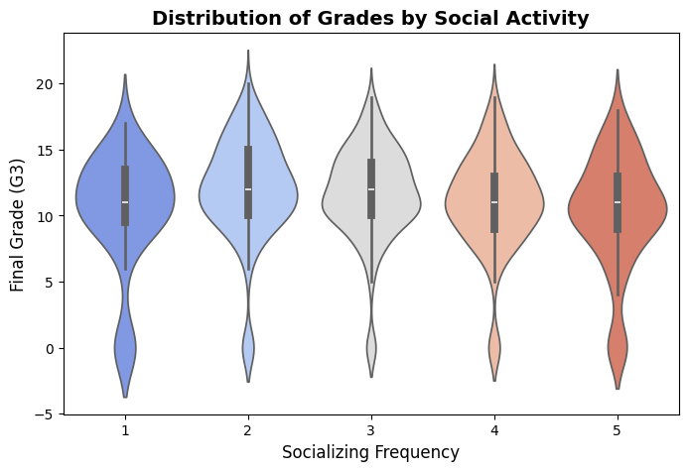
Ethan
Social Tendencies and their correlations
What impact do certain social tendencies have on the students’ likelihood to succeed? (e.g. Frequency of alcoholic consumption, social lives, extracurricular activities, romantic relationships, etc.)
Mother’s Education Level
Social Tendencies

Slide 21
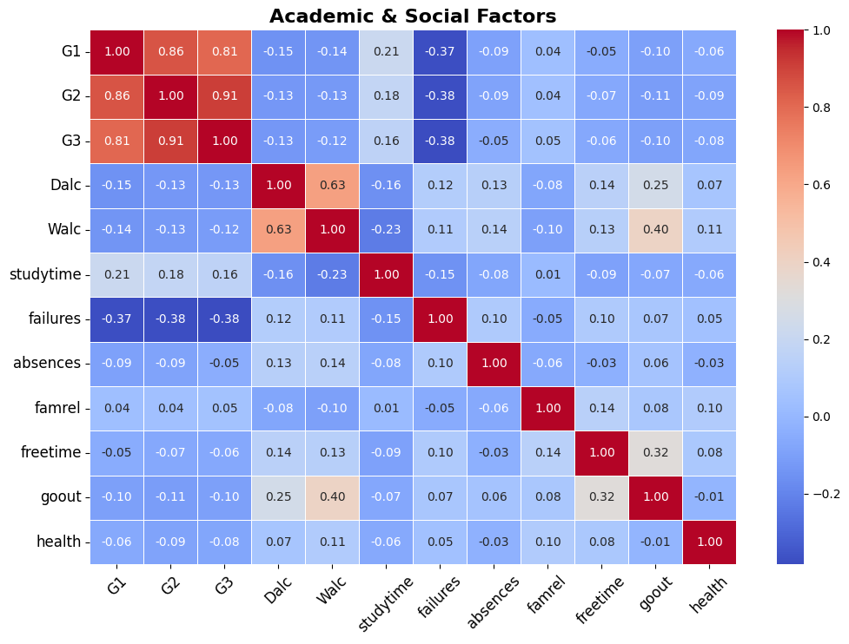
Social Tendencies and their correlations
Ethan

Slide 22
Nathaniel
Health and Family

Slide 23


Nathaniel
01
Does poor health often result in more absences and poorer grades?
How does health impact a person's likelihood to succeed?
02
Is there a high incidence of absence and failure among students classified in poor health?
03
Is there a correlation between health and quality of family relationships?

Slide 24
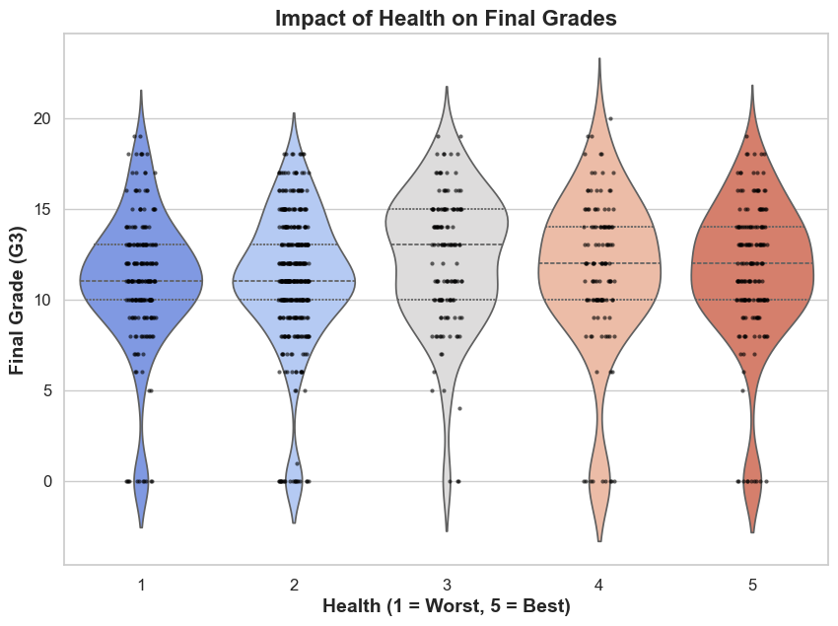
Nathaniel
Health & Success
There is a weak negative correlation with grades (ρ = -0.081, p = 0.009), suggesting that poor health slightly lowers grades.
Conclusion: While health may have some impact, it is not the main predictor of success.

Slide 25
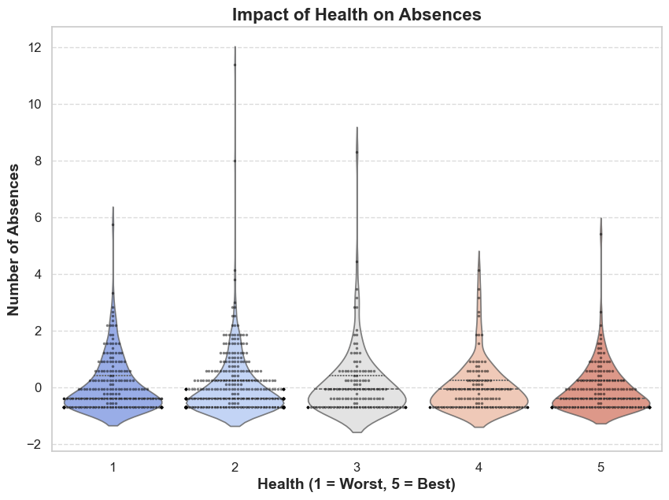
Nathaniel
Health and Absences
- No strong correlation **(ρ = -0.034, p = 0.267)** → Poor health **does not** increase absences.
- **Conclusion:** Health **affects grades more than attendance**.

Slide 26
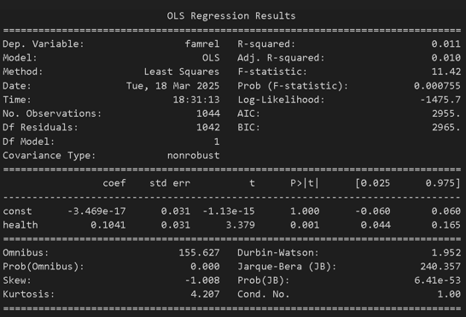
Nathaniel
Health & Family Relationships
- Weak positive correlation between health and quality of family relationships. **(ρ = 0.090, p = 0.0037)** → Healthier students report better family relationships.
- Conclusion: Family support may contribute to both better health and academic success.

Slide 27


Nathaniel
Implications
If schools want to identify at risk students, they should be looking at:
grades: sudden drops, failures
attendance: absence, engagement
mother’s education

Slide 28
Nathaniel
Summary & Conclusions
Successfully optimized our baseline model
A Decision Tree Model was most accurate
Less linear relationships
Some features heavily skewed the chances of a student being at risk
We realized that we could have made a features prediction earlier on to ensure we were analyzing the most impactful features

Slide 29





Thank
you!

